Slide 1
Welcome
Paula Hannan
hannanp@oit.edu
Last Changed: 08/11/26 05:42:47 AM

Slide 2
Welcome
Introductions
Book
  Problem Solving with C++ by Walter Savitch
Web site – http://www.capital.ous.edu/~hannanp
Class E-mail
Syllabus

Slide 3
How this Class May be Different
I like to connect with people. This means:
  Class attendance is required.
  Attendance is strongly encouraged for the first hour of the Saturday lab.
  Participation is encouraged.

Slide 4
Encouraing Class Attendance
Turn in a index card each class for 5 points
  Front => Three important points from this class
  Back =>
    One thing you think I should review next time. (This might be something you notice someone else struggling with.)
  Possibly some other question to help me structure the class.

Slide 5
Important Grading Changes
Style Guide
  I will use it when grading.
  It may have some changes.
  If you catch me not following it in examples and hands-on, you get points.

Slide 6
Important Grading Changes
Late Assignment coupon
  You can turn in 1 assignment up to 1 week late with 5% per day penalty.
  20 bonus points if you don't use it.
  CST116 Can't use this cupon for the 4th lab (since it will be due finals week.)

Slide 7
Important Grading Changes
I will accept pseudocode that looks like C++ code ONLY if it is handwritten.
  You may use // in your typewritten pseudocode if you want to copy it into your program for documentation.

Slide 8
How to Help Each Other
In your syllabus I've clarified how to help each other without stepping over the line.
I'm asking that you not leave your C++ code on the lab PC's.

Slide 9
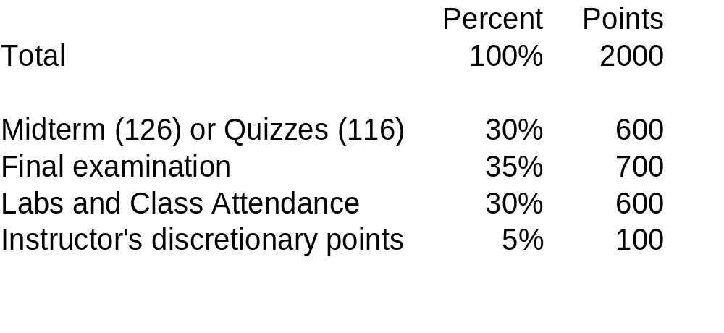
Grading

Slide 10
Using the OIT Lab
At your leisure refer to the lab guide.
Visual C++ has three things
    Workspaces – A grouping of projects – You'll probably have one for this class.
    Projects – Everything needed for a single .exe – You will probably have one for each lab, and you and at least one for the hands-on we do in class (scratchpad)
    Files – Your c++ program.

Slide 11
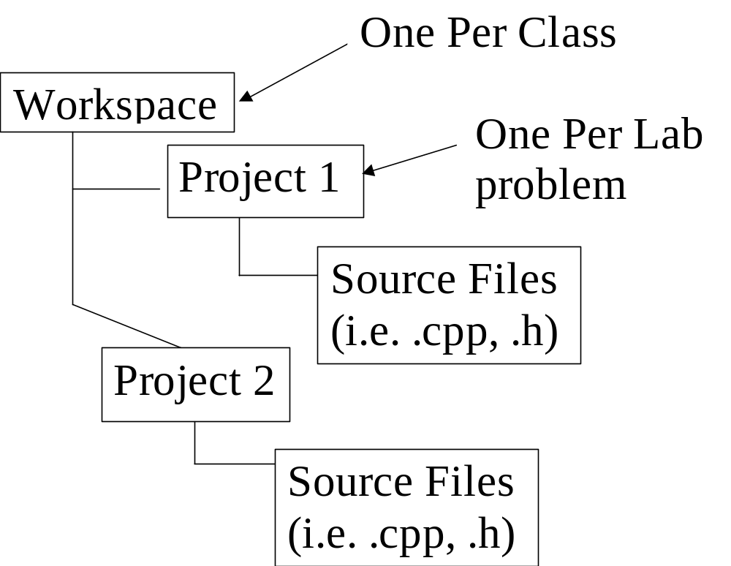
Visual C++ files

Slide 12
Hands-On Prep
Create a folder on the PC for this class. If one already exists, bop it. Create a subfolder with your name.
Files on the PC's can go KAPOOPSIE GOODBYE.
  Always Copy the .cpp file to a disk or email it to yourself.
  Protect your lab work (.cpp files or pseudocode) from copying either by removing them or using passworded zip files.

